Slide 1
"Effect" is complex - infinitely complex - but one can have no "knowledge" of effects. One can but be "informed" of effect. Information is not knowledge. Our educational process "informs" us but until we have recognised the eternal truth which underlies that information, we have no knowledge of it. . . "All knowledge" is possible for anyone - and the Cosmos gives it to him who asks but "all information" is impossible.
Walter Russell

Slide 2
The Ultimate Unification Theory
UUT
The Scientific Breakthrough that unify Science and Spirituality
Presented for: The Institute of Noetic Sciences
Brisbane, 11 September 2014
By Bambang Pramana
Notes:
Greetings everyone!
Welcome to the presentation of The Ultimate Unification Theory.
The scientific breakthrough that unites Science and Spirituality.
The topic sounds very heavy and scary
But before we start, please allow me to make an important statement:
I am not a super genius and I do not pretend to be more clever than Albert Einstein.
I am just a humble engineer with an average intelligence and a bad memory.
The UUT is not my invention. It has been there all the time waiting to be understood.
What I did is just connecting a few important dots and I was even guided to find those dots to be connected.
It all came to me as an epiphany in 1988 while watching a beautiful sunset at Seminyak Beach in Bali.
If I show you those dots and how to connect them, I believe every one with an average intelligence would be able to see the picture.
Of course only if they want to.
So, lets start.

Slide 3
Why unification?
It is the scientific method to search for underlying principle / law of nature governing a wide gamut of happenings with as small a number of rules as possible.
i.e.
Newtonian Law of Movement
This simple formula applies for every movement from an apple falling off the tree to satellites orbiting the Earth.
F = m . a
Notes:
The first dot is back to the 17th century, known as the Century of Rationalism – The Renaissance.
(Read the text slowly)

Slide 4
Beyond Newtonian border
Electromagnetic field
Special Relativity Theory (the world of super fast)
General Relativity Theory (the world of super vast)
Quantum Mechanics (the world of super small)
Notes:
The second dot is what happened around the turn of the 19th to 20th Century.
When we realized that the Newtonian Physics is only valid for macroscopic objects – things we can see and touch.
Beyond the Newtonian border we know of
- Electromagnetic field discovered by Michael Faraday
Albert Einstein came up with The Special and General Relativity Theory
And then Quantum Mechanics

Slide 5
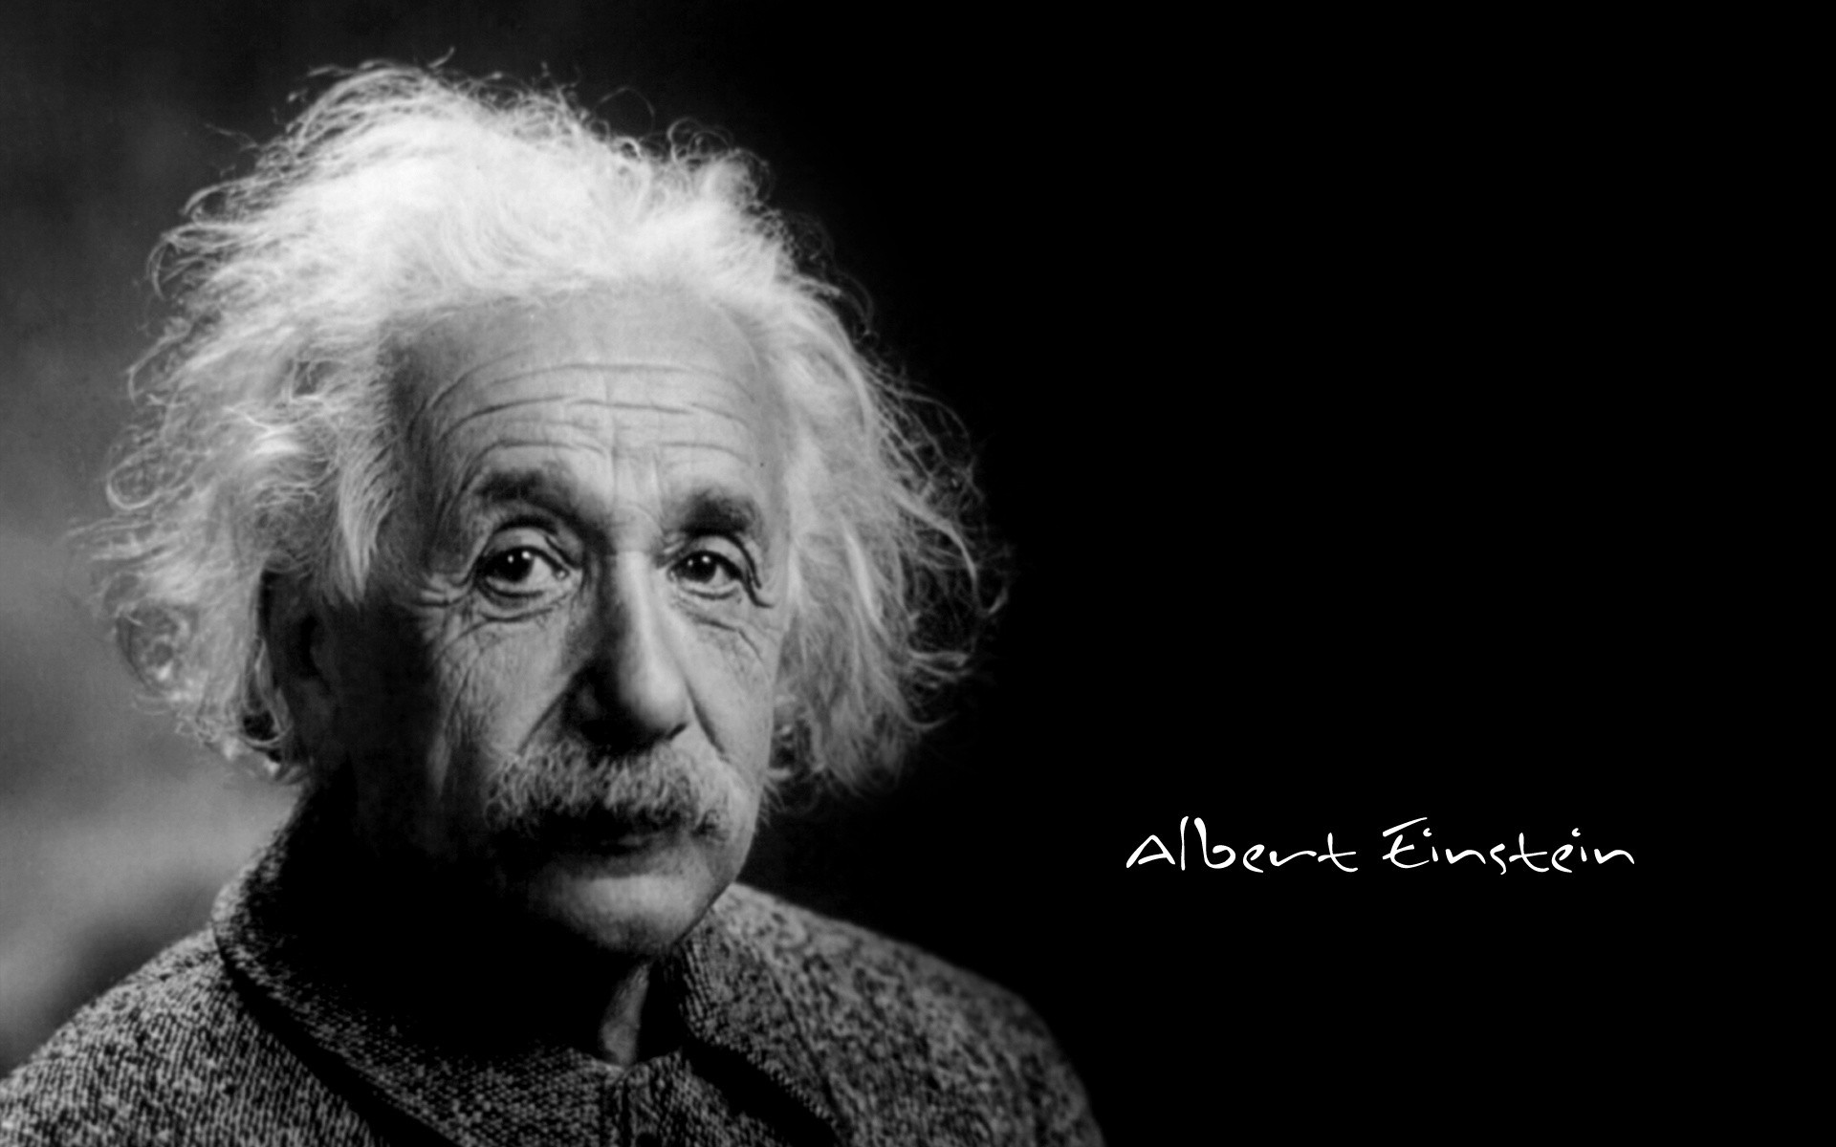
The new Physics
Matter is regarded as being constituted by region of space in which the field is very intense. . . .
There is no place in this new kind of Physics both for the field and matter, for the field is the only reality.
E = mc²
Mass = condensed Energy
Notes:
At the beginning of the 20th century we have our new Physics, where
Matter is regarded as being constituted by region of space in which the field is very intense.
There is no place in this new Physics both for the field and matter, for the field is the only reality.
Einstein came up with E=mc² , another simple and easy to remember formula, which actually states that Mass or matter is nothing but condensed Energy

Slide 6
Quantum Entanglement
Quantum:
  Two complementary particles travelling at the speed of light in opposite directions.
  If particle at A is deflected to the right – its complementary particle at B will turn left. (to complement its pair)
  This happens even if A and B are light-years away from each other. (A spooky action at distance / non-locality phenomena)
Relativity:
  How can those complementary particles communicate to each other across the distance. Since according to Relativity theory, nothing, not even information can travel faster than the speed of light.
Notes:
Once we resolved the paradox between Field and Matter we come to the third dot, the paradox between Relativity Theory and Quantum Mechanics that need to be reconciled.
It is also known recently as Quantum Entanglement.
(Read text slowly)
In 1989, Alan Aspect did an experiment that proved that complementary particles are always entangled to each other.
In science, this is not acceptable. A very spooky action at distance.
Physicists think there must be a loop hole some where.
The loophole could be anywhere, the design of the experiment, the equipment or the accuracy of the measuring instrument etc.

Slide 7
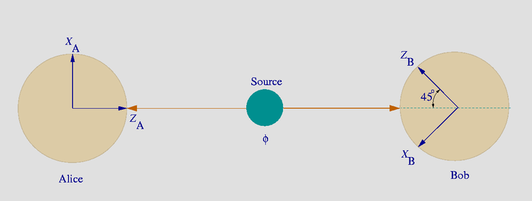
EPR Paradox - 1935
A source (centre) sends two complementary particles toward two observers, one to Alice (left) and the other one to Bob (right), who can perform spin measurements.
Notes:
Do not show this slide to shortened presentation
When the paradox of matter and field is resolved, we find another paradox arises between Relativity theory and Quantum Mechanics.
It is known as “Quantum non-locality phenomena or Quantum Entanglement”
Einstein said: “God doesn’t play dice”
One of the theory must be wrong.
If we have two different theories contradicting each other, we have not found the truth yet!
So, with his colleagues he devised a thought experiment known as the EPR paradox
challenging Neils Bohr theory of Quantum Mechanics.

Slide 8
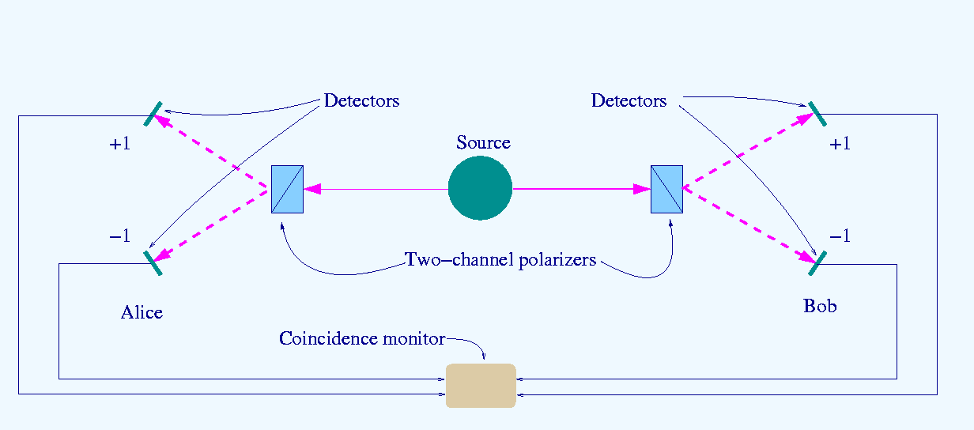
The Optical Bell Test Experiments
Scheme of a "two-channel" Bell test experiment
The source S produces pairs of "photons", sent in opposite directions. Each photon encounters a two-channel polariser whose orientation (a or b) can be set by the experimenter. Emerging signals from each channel are detected and coincidences of four types (++, −−, +− and −+) counted by the coincidence monitor.
Notes:
Do not show this slide to shortened presentation

Slide 9
Closing all possible loopholes
Optical Bell test experiments
  Freedman and Clauser, 1972
  Aspect, 1981-2
  Tittel and the Geneva group, 1998
  Weihs' experiment under "strict Einstein locality" conditions
  Pan et al.'s (2000) experiment on the GHZ state
  Rowe et al. (2001) are the first to close the detection loophole
  Gröblacher et al. (2007) test of Leggett-type non-local realist theories
  Salart et al. (2008) Separation in a Bell Test
  Ansmann et al. (2009) Overcoming the detection loophole in solid state
  Giustina et al. (2013) Overcoming the detection loophole for photons
All the above proved that Quantum Mechanics is correct
Notes:
The 10 experiments trying to close all possible loopholes.
The most recent experiment was just last year in 2013.
And everything confirmed the Quantum Entanglement phenomena.
Was Einstein wrong?
Some scientist tried to escape this dilemma by ‘inventing’ superluminal connections or Tachyons theory, but I don’t think it is the way-out.
Science becomes fragmented and incoherent.

Slide 10
Was Einstein wrong?
The twist of the mind
The loophole is actually in our mind.
  The Relativity theory shows that time and space are relative to our system of reference.
  They are so relative, that if we use ‘the movement at the speed of light’ as our system reference, time and space become insignificant.
  Consequently, ‘speed’ as a dimension of ‘space over time’ (km/h) also becomes irrelevant.
Notes:
(Read text slowly)
This is one very important point to remember.

Slide 11
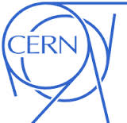
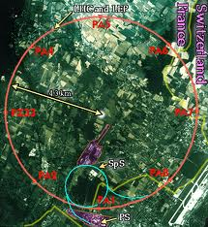
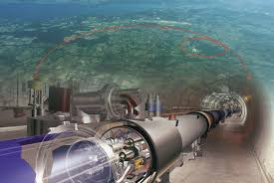
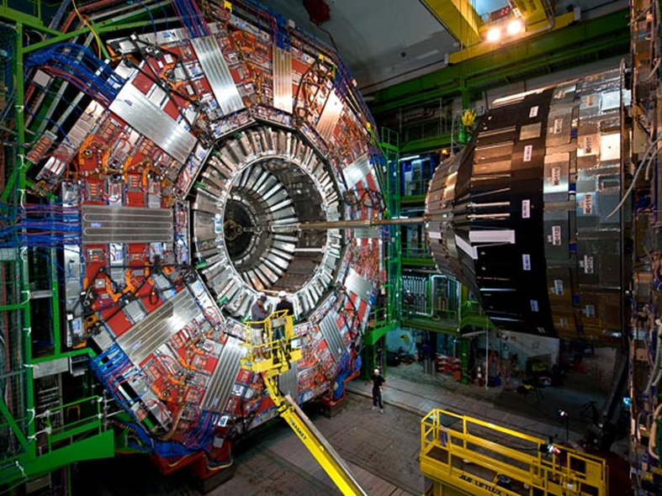
Particle Accelerator
Notes:
Here we come the fourth dot. The Particle Accelerator CERN in Switzerland.
Any one knows why we accelerate particles?

Slide 12
The Gamma (γ) factor
Gamma factor is the basic principle of any experiment using particle accelerator.
  To make them easier detectable particles are accelerated close to the speed of light.
  At that speed their clock slows down & their mass grow
  They become bigger and live longer
The only limitation is that they can’t be accelerated to 100% c.
  Close to the speed of light the energy we pump is converted into mass.
Notes:
(Read text slowly)

Slide 13
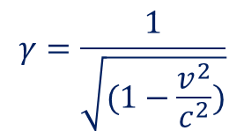
The Twin Paradox
Twin paradox:
  If one of the twin travels at 90%c where γ=2.3 his clock tick 2.3 times slower that his twin on Earth.
  After 10 years his twin on Earth has aged 23 years, 13 years older
  He will passed Alpha Centaury, which is 4.3 light years away in less than 2 years.
  He will ‘feel’ as if he is travelling twice as fast as the speed of light.
  To his condition the Universe has shrank to half its size.
At 100% c; γ = infinite
  His clock stops and space shrinks into nothing.
  He can cross the whole Universe in no time (instantaneous)
  However, this is hypothetical since only massless particles i.e. photon can reach the speed of light.
Notes:
The validity of Gamma Factor created another paradox – known as the Twin Paradox
(Read text slowly)
This is hypothetical, since no particle with mass can be accelerated to c, since its mass will become infinitely large. (as large as the Universe?)
Only Photon / light particles has no mass.
At the speed of light photon is theoretically as large as the whole Universe – in form of wave.

Slide 14
The Movement at c
For a light particle that moves at the speed of light, its clock stops and space shrinks into nothing.
Hence, photon / light particle does not age, and is everywhere at the same time.
Two complementary particles that appear to us as if they travel at the speed of light in opposite directions are in fact do not moved at all. They are still together – indivisible.
The Universe is to us as what it is, only because we are as what we are. Time-space continuum as we perceive it, exist in our mind only because the interactions between our senses and its surrounding gives our mind those impressions. It is real, only as far as our physical senses are concerned.
Notes:
(Read text slowly)

Slide 15
The First Breakthrough
Relativity & Quantum united
If Einstein had only pushed his Relativity Theory to the farthest end, and applied “the movement at the speed of light” as his frame of reference, he wouldn’t wasted his time arguing with Neils Bohr, but realized that:
The true and eternal reality is “the reality at the speed of light” or “the reality of light”, where time stops – therefore patterns cease to be cyclic, periodic or time dependant and space shrinks; hence separateness cease to exist.
Time-space and the whole Universe become singularity - The Absolute Infinite ONE-ness.
Notes:
(Read text slowly)

Slide 16
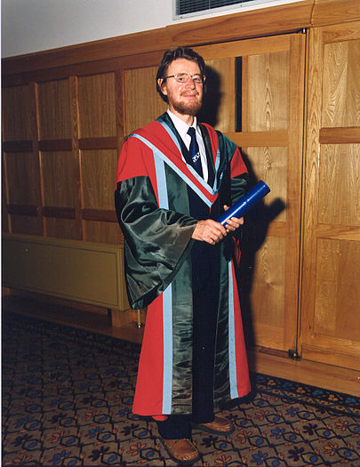
The newer Physics
The Universe is not a collection of objects but is an inseparable web of vibrating energy patterns in which no one component has reality independently from the entirety. Included in the entirety is the observer
Professor Paul Davies summarises
Bell’s theorem on the indivisibility of the Universe
The Law of ONE
John Steward Bell receiving an Honorary degree at Queen's University Belfast, July 1988
Notes:
The fifth and final dot in Science!
This is The State of The Art in Science (Physics)

Slide 17
The new paradigm
Old Newtonian
Atomistic
Matter based
paradigm
New paradigm
of inseparable
web of vibrating
energy patterns
Notes:
Consequently we need to change our paradigm.

Slide 18
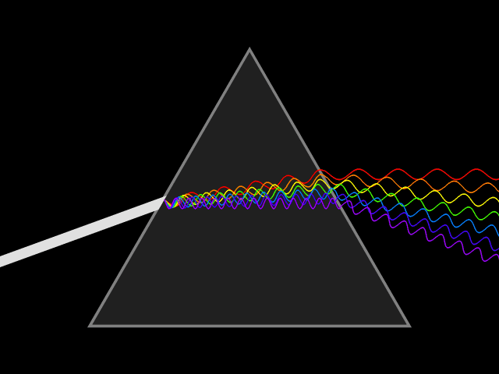
The Reality of Light
Dispersed,
polarized,
individualized
but
inseparable
One-ness
Source: Wikipedia
Notes:
The Reality of LIGHT:
ONE-ness vs Dispersed, polarized, individualized but still inseparable.

Slide 19
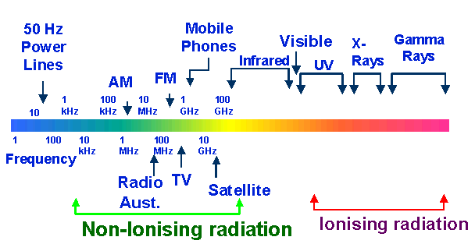
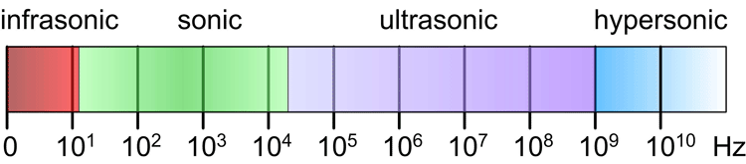
Frequency spectrum
Speed
300,000
km/sec
Electro-magnetic
Sonic
343 m/sec
Notes:
In Our current day to day reality:
Visible light that our eyes can resonate to is a very small bandwidth.
Imagine if our eyes resonate to X-ray range. – We will see only skeleton walking around us.
On the other hand,
We live in this mobile phone technology era.
Do we know what is happening when your phone ring and a friend from overseas talks to you on the phone?
How can he talk to your ear directly while he is far away on the other side of the world?
What happens with the radio waves in the air?
There can be thousands of phone conversations in this airwaves, using the same frequency band and on the air we can’t separate them.
But our mobile phone can, because of a certain patterns, the phone number.
Without those airwaves, our mobile phone is dead.

Slide 20
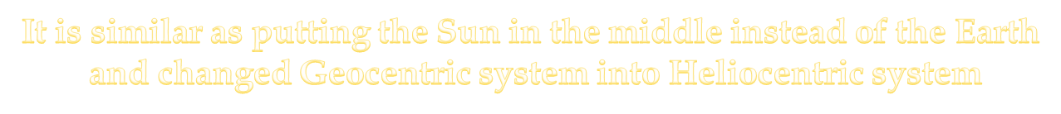
Breaking through the scientific barrier
Turning around the system of reference
Actually, there is no point in space that can be considered as 100% stationary to be used as point of reference.
Whereas the speed of light is always constant and equal “c” irrespective how we measure it.
Instead of using any arbitrary point in space as reference why don’t we use the speed of light or the condition of light as our system of reference?
Notes:
If we walk with at 5km/h on a train that moves at 80km/h, what is our speed? 5km/h to the train
But to the Earth, it can be either 85km/h or 75km/h depends on which direction we are walking.
But how fast are we measured from the Sun? (this is the Galilean relativity)
(Read text slowly)

Slide 21
The Future of Science / Meta-science
We always take for granted and never really asked ourselves, whether our four dimensional time-space continuum, - our reality, is truly real.
Similarly we didn’t asked ourselves for millennia whether the sky really rotates around our globe.
Even Einstein was ‘caught up’ in our ‘reality’ and could not agree with Neils Bohr about ‘quantum uncertainty principle’ and the ‘indivisibility of quantum reality’.
Taking “the reality of light” as our system of reference, we would not speak of “speed” anymore, but “degree of confinement” instead.
Light can be considered as “free energy”, while mass or matter is “confined energy”, known as “condensed energy”.
Notes:
(Read text slowly)

Slide 22
Degree of Confinement / Densities
The Implicate Order
The reality of light
V
Light
Sight
wave
photon
causal
mental
Human
The Explicate Order
IV
Sound
Hearing
K
subatomic
particles
astral
emotional
Mammals
Q
III
Gaseous
Smell
atomic
etheric
energetic
Animals
L
P
II
Liquid
Taste
elements
physic
organic
Vegetation
M
O
I
Solid
Touch
Mineral
N
N
crystals inorganic
Thermo nuclear
Fe, Co, Ni
Neutron capture
Electron shells
Notes:
Physics has gone from D-I to D-V on the left (show with laser pointer).
A bottom – up approach, and reached the wave/particle dualism in the reality of light.
According to the periodic table – all elements from Hydrogen to Fe, Co & Ni (in increasing Atomic number) are formed by Thermo Nuclear process due to gravity.
From thereon they are formed by a different process, known as Neutron Capture.
Does the natural law of Physics applicable on the left hand side also apply for the right hand side? Not necessarily!
Ask Robert Lanza – Biocentrism or Bruce Lipton – Biologist. – The Top-down approach.
It is like “Involution vs Evolution process”
The Reductionist method vs Expansionist.
The Bottom-up vs Top-down approach
We will get back to this picture later.
And let’s see the next big dot – Spirituality or Mysticism.

Slide 23
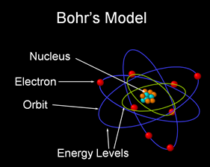
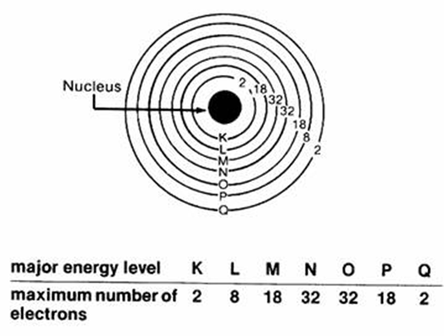
Atomic model
Notes:
Just to explain the electron shells

Slide 24


Mysticism / Spirituality
The Secret Doctrine – H.P. Blavatsky
  Volume I – Cosmogenesis
  Volume II – Anthropogenesis
The Stanzas of Dzyan – (original in Senzar from the Atlantean era)
  7 Stanzas – Cosmogenesis
  12 Stanzas – Anthropogenesis
The Ancient Palm Leaves – believed to be the most ancient manuscript on the planet, even older than humanity / our species. Contain highly ‘magnetized’ symbols and the interpretation is left to our ability to resonate.
The Purânas in India
The Tibetan Book of Kiu-te
Ancient Hebrew Document Sefer Yetzirah
Sacred volumes of the Egyptian Thoth-Hermes
Notes:
When we are talking about Spirituality or Mysticism, where do we start?
There are so many Religions or Spiritual teachings. Which one shall we pick.
So, I was guided to start with The Secret Doctrine written by Mdme Blavatsky in 1888.
There are two big books, and I don’t think I can digest or even remember what is in it. I simply don’t have the memory capacity to remember all those.
Then I found out that The skeleton of HPB SD is the Stanzas of Dzyan, which is believed to have originated from Atlantis.
Many interpretation derived from The Stanzas of Dzyan:
The Tibetan Book of Kiu-te etc.
Then I also found out that The Essence of The Stanzas of Dzyan is the Ancient Palm Leaves, which is believed to be given by our Elders.
These symbols are highly ‘magnetized’ and the interpretation is left to our ability to resonate.
In Spirituality we know the saying: “When the student is ready, The Master will arrive”
What it says is simply “when I haven’t learned the basic math, I would not be able to understand advance Calculus”
If I haven’t learned the English language, I won’t understand people talking in English.
Those ancient interpretations are based on people’s understanding in those era, which is totally different than our era of Relativity and Quantum Physics with Mobile and Internet technology.

Slide 25
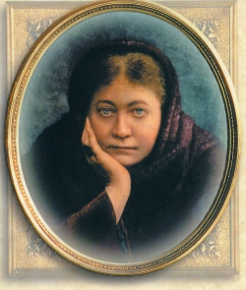
The most ancient manuscript
The Formula
“ . . . An Archaic Manuscript – a collection of palm leaves made impermeable to water, fire and air, by some specific unknown process – is before the writer’s eye.
On the first page is an immaculate white disk within a dull back ground.
On the following page, the same disk, but with a centre point. . . . . .
In it’s third stage the point is transformed into a diameter. . . . . .
When the diameter line is crossed by a vertical one, it becomes the mundane cross . . . .”
H.P. Blavatsky – The Secret Doctrine
Notes:
The above mentioned palm leaves supposed to be the most ancient manuscript on this planet,
and it is believed to be even older than humankind itself.
It contains 'highly magnetized' symbols and the interpretation of them is left to our own ability to resonate.
If we use our current way of linear – left-brain thinking we will end up saying as it says: A mundane Cross. – full stop. nothing special.
Here we need to turn on our Intuitive Faculty – The right brain thinking.
To me it explains the whole Cosmos.
I was contemplating on those four symbols when the epiphany happened to me in 1988.
It was a big Eureka!
At a sudden I know everything I needed to know.
However, I am not able to explain it using our limited language and concepts.
So, please if you are interested, try to contemplate and understand the way you need to understand.
Don’t get stuck on my ‘words’ / label.
Stick with the symbols. Once you put a label, you restrict them. Language hides Truth.
The followings are only my attempt to help prompting your ‘intuitive faculty’ using words and concept I am familiar with.

Slide 26

The Law of ONE
On the first page is an immaculate white disk within a dull back ground
The Circle symbolize the Source,
The Absolute ONE-ness, infinite, boundless without beginning nor end.
The Void / the zero, the nothing that is everything.
Notes:
Don’t stick to my words!
Use your own words and understanding.

Slide 27
The Law of Polarization
On the following page, the same disk, but with a centre point. . . . . .
The appearance of the Centre Point symbolize the first polarization, the point of awareness within.
The Source becoming aware of It-Self.
Notes:
As an example we can also be aware of ourselves, our feet, our hand, emotions, thoughts etc.
Again, don’t get stuck to my words. Use your own intuitive capability.

Slide 28
The Law of Polarization
In it’s third stage the point is transformed into a diameter. .
Polarizing the circle into the upper half;
The Li, Heaven, Yang (masculine), Spirit.
The world of no form (arupa) beyond time-space.
The blueprint, the principles, the archetypes, the causal
The Implicate Order. (Quantum realm)
and the lower half;
The Chi, Virgin Energy, Earth, Yin (feminine), Matter
The world of form (rupa) within time-space continuum
The manifestation
The Explicate Order (Newtonian realm)
Notes:
I hope I gave you enough prompting.

Slide 29
The Law of Interaction
When the diameter line is crossed by a vertical one (the |), it becomes the mundane cross . . . .” (the symbol of creation)
The Heaven /Yang (Li) impregnated the mundane egg / The World / Yin (Chi)
Let there be Light!
The Spirit manifested into Matter.
The collapse of probability waves /turns into matter.
The Implicate Order unfolded to the Explicate Order
The Interaction between Spirit and Matter symbolises by the vertical axis (|) creates Consciousness. At the same time it also polarized the ONE into Subject (the |) and Object (the surrounding).
Notes:
(Read text slowly)

Slide 30
The Esoteric Axis
The | - the vertical axis symbolize the interaction between Spirit and Matter polarity.
It symbolize the Subject pattern, that can be anything from a simple patterns as light particle to a complex pattern as human to a Galaxy and Super Universe.
This interaction between Spirit and Matter creates Consciousness within the Subject pattern.
Degree of consciousness directly relates to the complexity of the subject patterns.
This law of polarization is also known as the universal law of Freewill.
  At human level, metaphorically we can consider it as choosing a certain colour of hat that we are wearing to experience our surroundings. Wearing a Grey coloured hat we will see the glass as half empty, while wearing rose a colour hat we will see the glass as half full.
Notes:
(Read text slowly)
In the UUT all patterns from photon to Super Universe are LIFE Patterns having different level of complexity.
There is no more dichotomy between alive and dead matter.

Slide 31
The Exoteric Axis
The horizontal line symbolize the interaction between the subject pattern (the |) and the surroundings – the object.
Due to the principle of resonance and inductions whatever the subject can perceive from the surrounding solely depends on the subject pattern itself.
  Eyes can only perceive a certain bandwidth of light (Red to Violet)
  Ears can only perceive a certain bandwidth of sounds (20 to 20kHz)
  Wearing a grey coloured hat we see the glass is half empty while wearing a rose coloured hat the glass is half full etc.
It is possible and even highly probable that there are many other Universes sharing our space without us being aware of them simply because they are vibrating beyond our resonance bandwidth
“The Universe is to us as what it is only because we are as what we are.” – Albert Einstein.
Notes:
(Read text slowly)

Slide 32
The principle of
Resonance & Inductions
The principle of resonance postulates that interaction between patterns can only occur if they correspond to each other within a certain resonance bandwidth.
While resonating, the induction principle underlies the interaction between the polarities, changing and modifying the patterns.
This induction principle in turn is the fundamental cause of universal evolution.
Notes:
I use this because I happen to be an electrical engineer.
To me it says all, though I am fully aware it may needs more explanations.

Slide 33
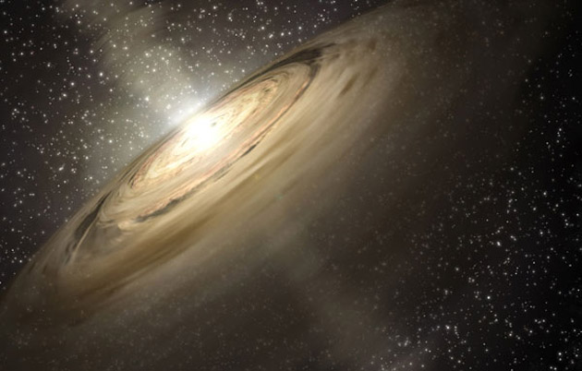
Galaxy formation

Slide 34
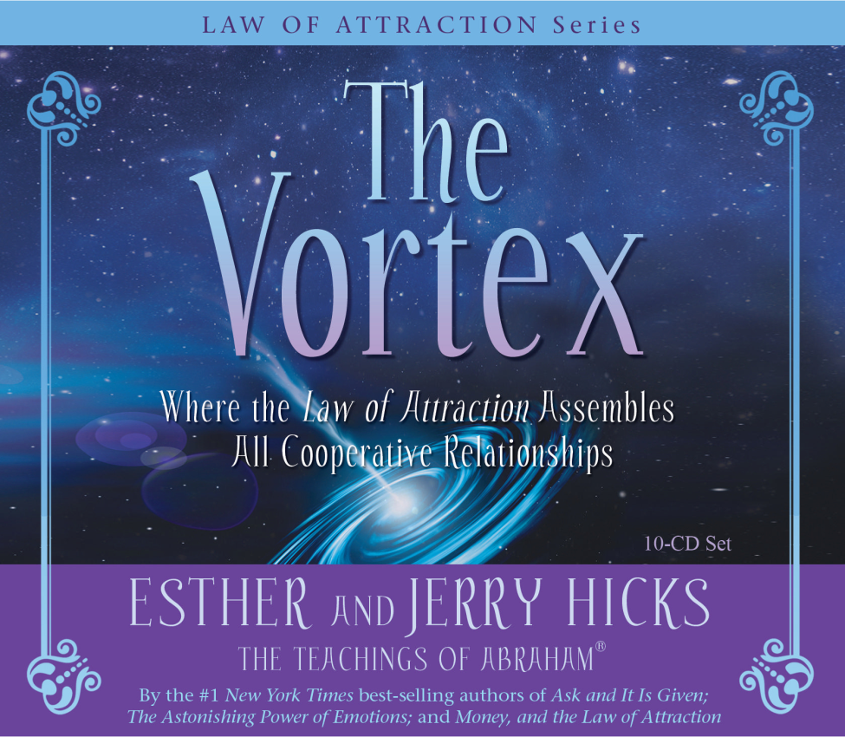
The Vortex

Slide 35
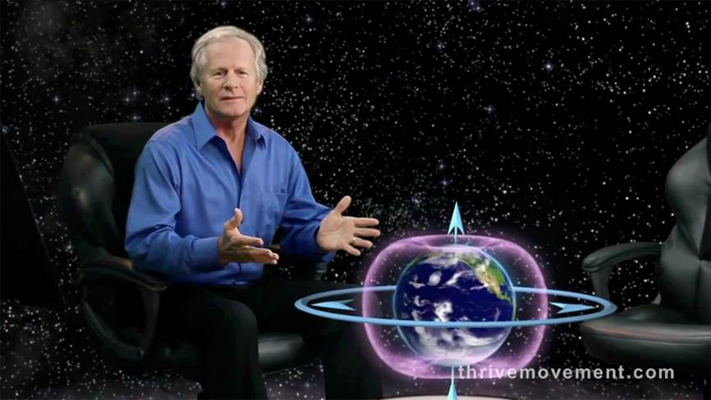
The Torus

Slide 36
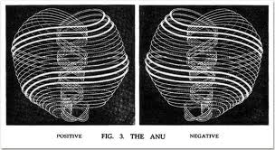
The ANU
As perceived clairvoyantly by C.W. Leadbeater – Occult Chemistry 1908
Notes:
Just a question:
Science still don’t know what gravity is.
Science know only the effect of gravity.
But that is also not accurate.
They need to ‘invent’ dark matter to make their calculation have any meaning,
There are simply not enough mass to create gravity known in the Universe or within the Galaxy.
Any body got an intuitive answer as what gravity is?

Slide 37
Consciousness
Spirit – Matter Interaction
Spirit
Un-Consciousness
Mental
Emotional
Physical
Focus of awareness
(centre point)
Consciousness
Sub-Consciousness
Matter
Notes:
This may be totally new definition of “consciousness”, not used anywhere else.
Consciousness arises from the interactions between Spirit and Matter – interaction between mind and brain.
Back to the Vertical axis, even a photon has a level of consciousness that is much more simpler than human consciousness.
A photon could only relate to some sub-atomic particles of our physical body, as we human can relate to the Galaxy or Universe with level consciousness far more complex than ours. (We can only see the planets and the stars)

Slide 38
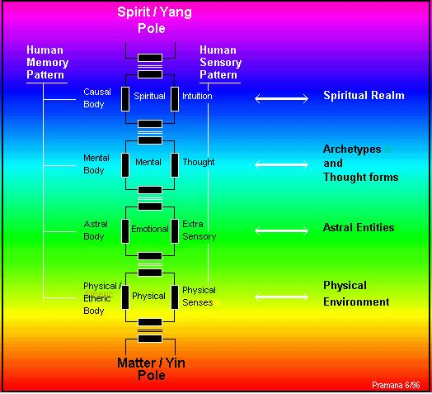
Human as superimposed energy circuits
blockage
Notes:
Here again, as electrical engineer, the model is so explanatory for me.
The normally preferred condition is, when all the circuits are in sync with each other.
In human, this means that our life is the perfect expression of our spirit.
If one of the circuits is not in sync, energy is trapped within the circuit and the flow is disturbed.
In human this creates dis-ease.
In mental circuit it may creates depressions, in emotional circuit – a trauma, in physical circuit a physical dis-ease, sickness etc.
Healing is tuning those circuits to sync with each other, by adjusting the ‘memory’ part of the circuit.
Like tuning a radio.
(Free discussions if time permits)

Slide 39
Degree of Confinement / Densities
The Implicate Order
The reality of light
V
Light
Sight
wave
photon
causal
mental
Human
The Explicate Order
IV
Sound
Hearing
K
subatomic
particles
astral
emotional
Mammals
Q
III
Gaseous
Smell
atomic
etheric
energetic
Animals
L
P
II
Liquid
Taste
elements
physic
organic
Vegetation
M
O
I
Solid
Touch
Mineral
N
N
Thermo nuclear
crystals inorganic
Neutron capture
Involution
Fe, Co, Ni
Evolution
Electron shells
Notes:
Free discussions if time permit.
Densities! And Dimensions confusion!
Ascensions from 3D to 4D to 5D – is just remembering who we really are! – Light being! Furthermore, we are the Source.
We are suppressed in 3D – in survival mode and used our thinking capacity for our survival – Survival of the fittest philosophy? Cunning, competitive instead of cooperative.

Slide 40
The Fundamental Cosmic Laws
The Law of ONE
The Law of Polarization
The Law of Interactions
Based on Resonance & Induction principle

Slide 41
The Philosophical Summary
Every “I” is the same “I”, which is the Cosmic “I”.
The only difference is the Subject patterns held as point of reference to experience other patterns – the Object.
Due to Subject ⬄ Object Polarization, the Subject pattern identify itself as “I am” having the impression of being separated from the rest of the Cosmos, which is its Illusion.
The SOURCE is experiencing IT-SELF through us
As infinite number of subjects having infinite number of experiences.

Slide 42
THANK YOU

