Slide 1
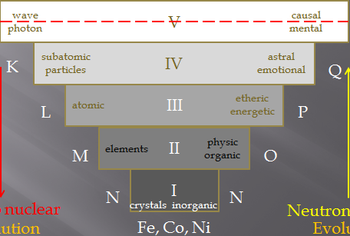
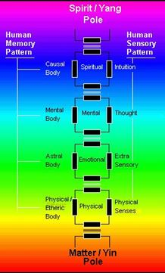
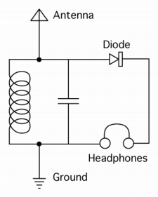
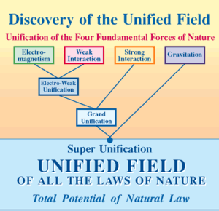
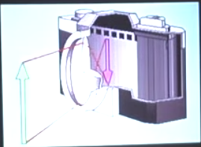
Talking to DeeNA
Subconscious Unconscious
Dimensions vs Densities
Quantum Probability waves
vs
Thoughts / Imagination
Morphogenetic
Field
Implicate
order
No time
No space
Quantum State
Speed
of
light
Morphic
Resonance
Consciousness
Explicate
order
Time
Space
Epigenetic
Gene
DNA
Ultimate
Unification
Noetic
Sciences
F=ma
E=mc²

Slide 2
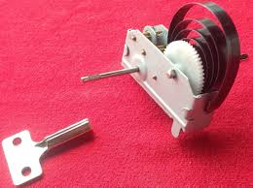
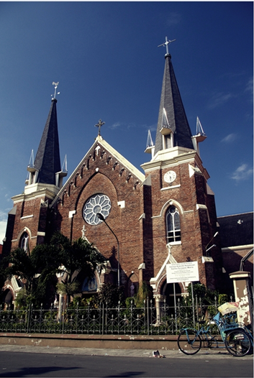
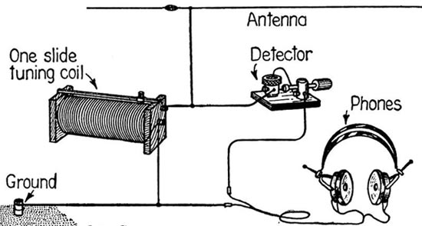
Childhood curiosity
10 years old
4 – 5 years old
Opened up all wind-up toys just to know
how it works
How come God can be in many churches at the same time?
But so is radio signal!
My first
Crystal radio

Slide 3
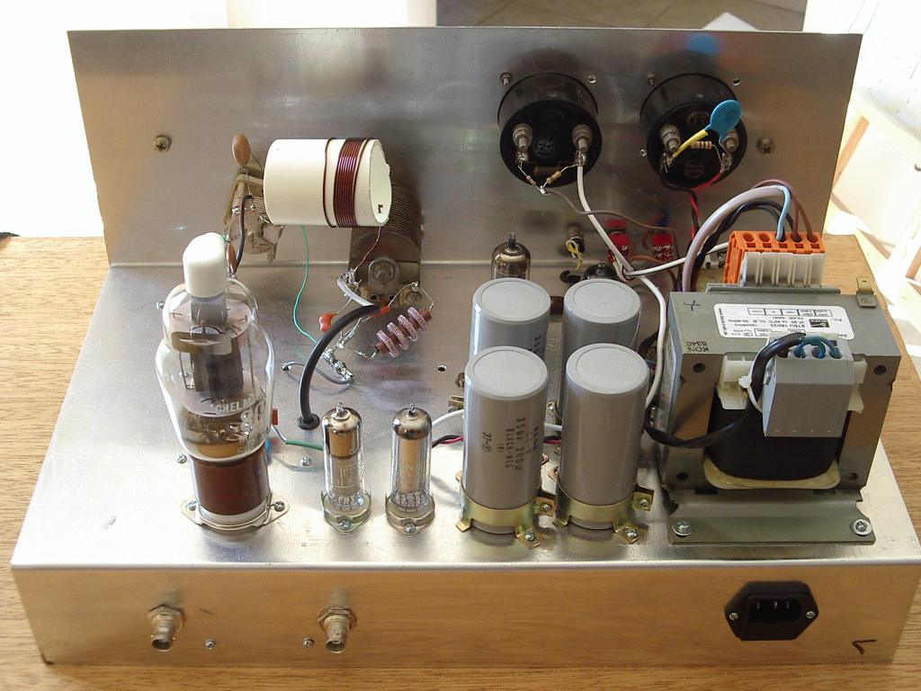
Build my first amateur radio transceiver at 12

Slide 4
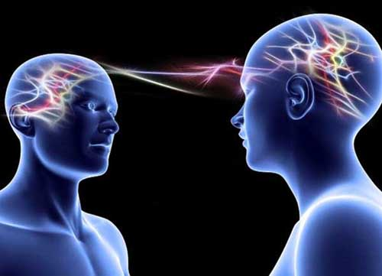
Telepathy and other paranormal phenomenon.
How do they work?
Do they work like
Radio transceiver
?

Slide 5
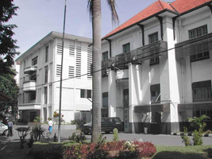
St. Louis - Surabaya Senior High school
1965 – 1968
Div. Exacta
(Maths & Physics)
Why Exacta?
There is only one correct answer
No ambiguity
No argumentation
No debates
Prior to Science:
TRIVIUM:
Grammar
Logic
Rhetoric

Slide 6
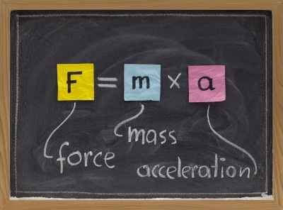
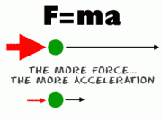
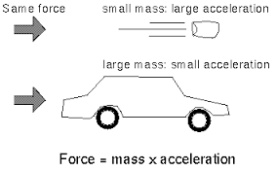
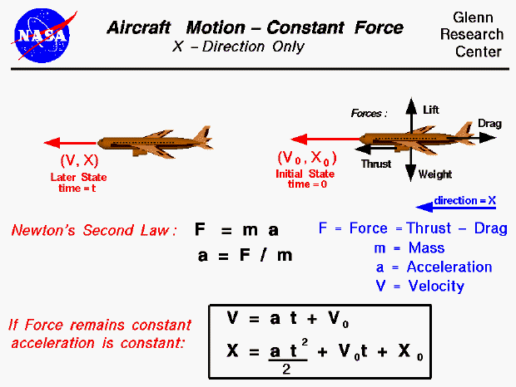
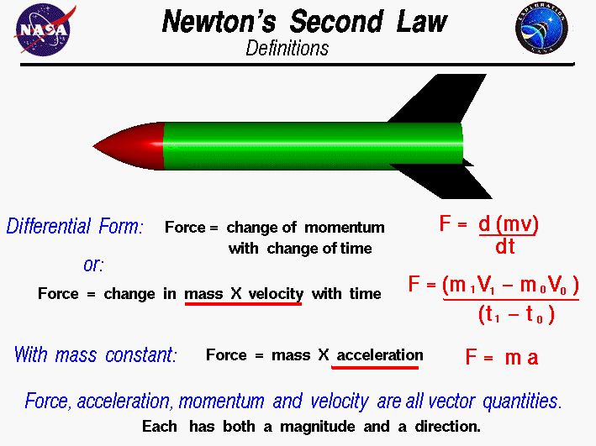
Newton’s Law of Movement
The formula = a simple underlying principle

Slide 7
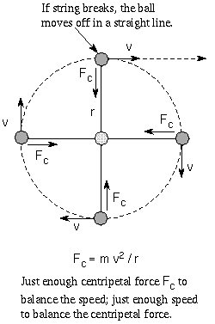
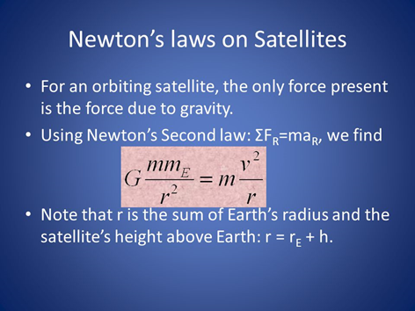
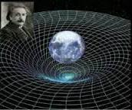
Newton’s Law on Satellites
GPS Satellite inaccuracy
1mile/7years
Correction by
General Relativity
(curved space)

Slide 8
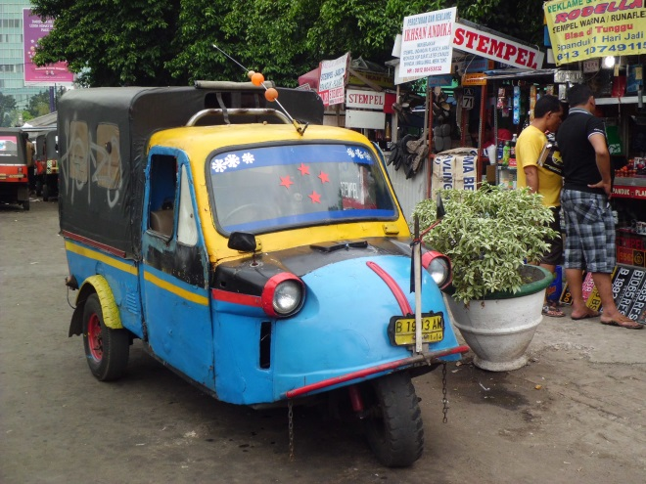
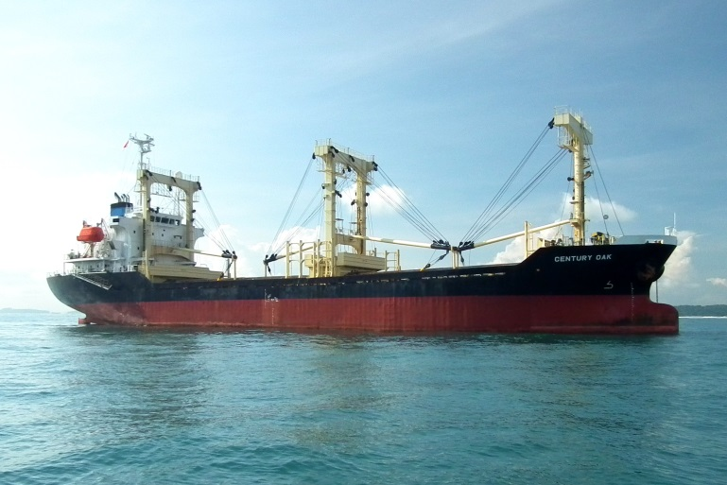

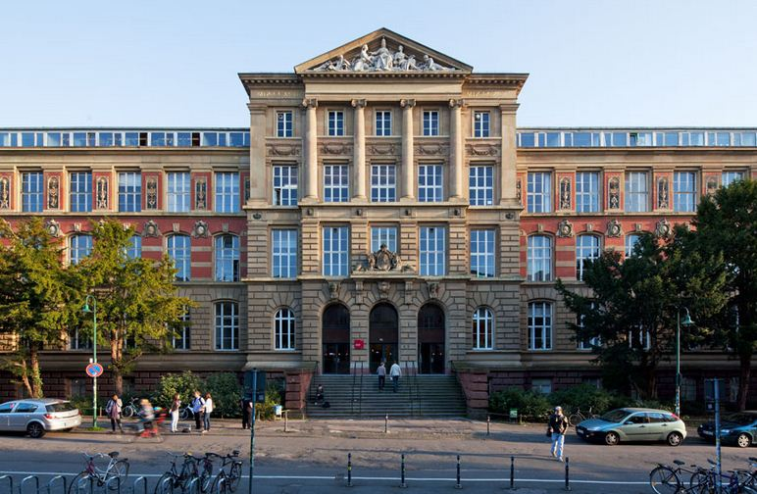
Going to Germany 1969 - 1978
1972 BSc in Electrical Engineering
1976 MSc in Control System Technology
Thesis: Manual Control System
1978 Post Graduate (second degree) in
International Industrial Management (MBA)

Slide 9
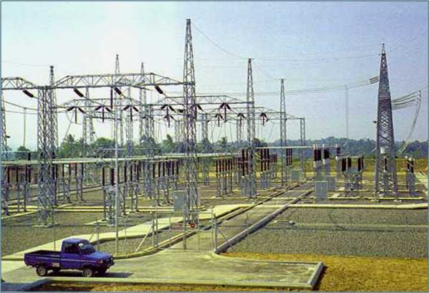
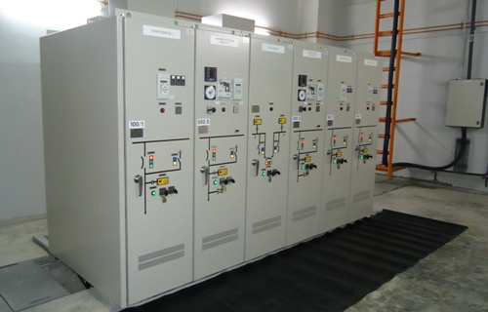

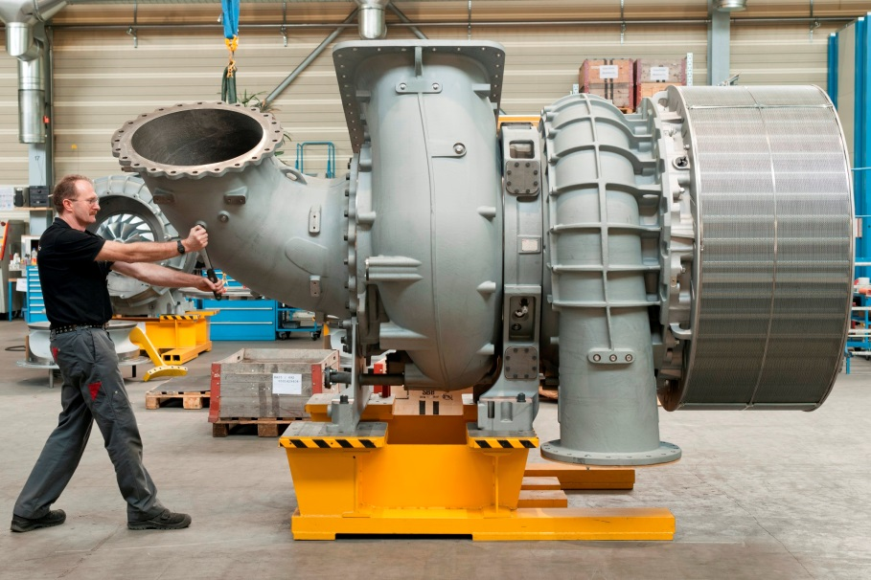

Back to Indonesia
150 - 500kV Substations projects
22kV Switchgear assembly
Concrete Poles
20,000 / y
Miniature
Circuit Breakers
2,000,000 / y
Turbocharger
Service
Workshop

Slide 10
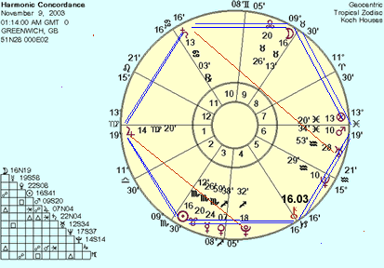
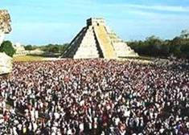
The Turning Point
16 – 17 August 1987
Harmonic Convergence
  The First Global Synchronised Meditation

Slide 11
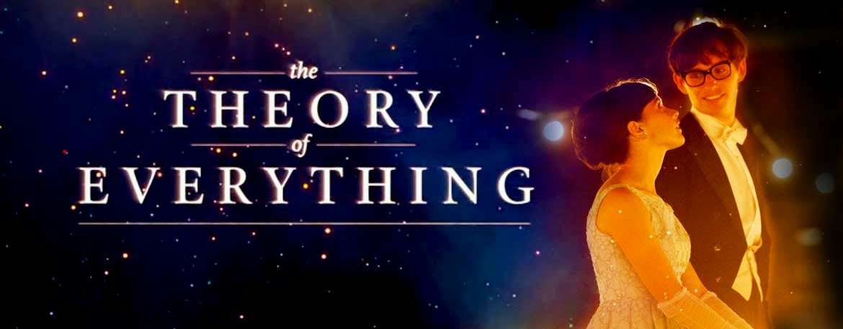
Unification of Scientific Theories
+
Noetic Sciences
=
Ultimate Unification
(Fundamental Cosmic Laws)

Slide 12

The Formula
“ . . . An Archaic Manuscript – a collection of palm leaves made impermeable to water, fire and air, by some specific unknown process – is before the writer’s eye.
On the first page is an immaculate white disk within a dull back ground.
On the following page, the same disk, but with a centre point. . . . . .
In it’s third stage the point is transformed into a diameter. . . . . .
When the diameter line is crossed by a vertical one, it becomes the mundane cross . . . .”
H.P. Blavatsky – The Secret Doctrine

Slide 13
The Esoteric Axis
Spirit – Matter Interaction
Spirit
Un-Consciousness
Mental
Emotional
Physical
Focus of awareness
(centre point)
Consciousness
Sub-Consciousness
Matter

Slide 14
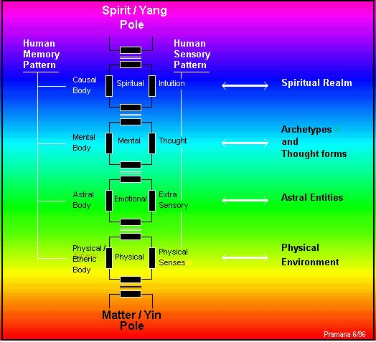
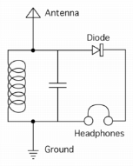

Human as superimposed energy circuits

Slide 15
Back
The Exoteric Axis
Degree of Confinement / Densities
The Implicate Order
The reality of light
V
Light
Sight
wave
photon
causal
mental
Human
IV
The Explicate Order
Sound
Hearing
K
subatomic
particles
astral
emotional
Mammals
Q
III
Gaseous
Smell
atomic
etheric
energetic
Animals
L
P
II
Liquid
Taste
molecular
elements
physic
organic
Vegetation
M
O
Solid
Touch
I
Mineral
N
N
Thermo nuclear
crystals inorganic
Neutron capture
Involution
Fe, Co, Ni
Evolution
Electron shells

Slide 16
