Slide 1
Human consciousness at the speed of light
Creating Heaven on Earth
Inner Circle Study Group
February 2017 topic

Slide 2
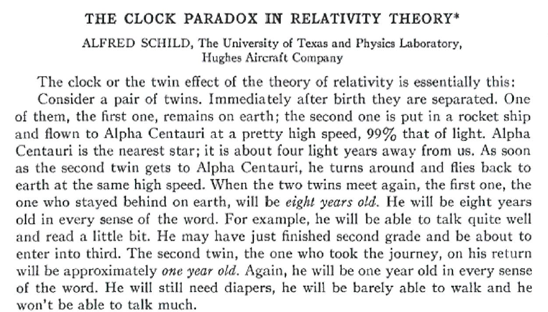
The Clock Paradox in Relativity Theory

Slide 3
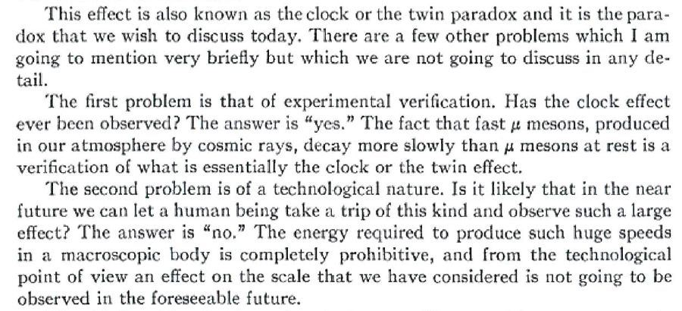
The Clock Paradox in Relativity Theory

Slide 4
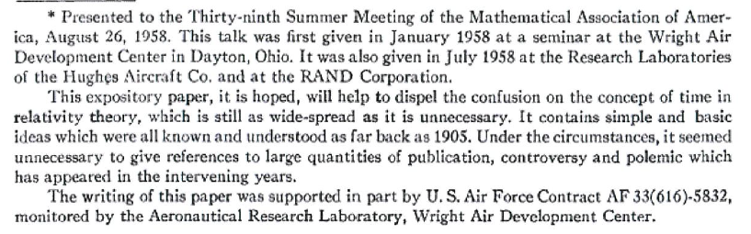
The footnote:

Slide 5
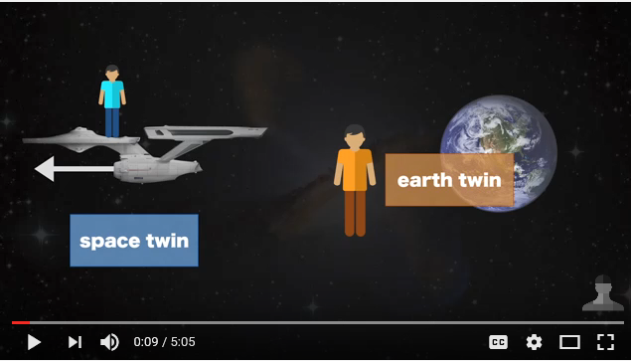
The Twin Paradox

Slide 6
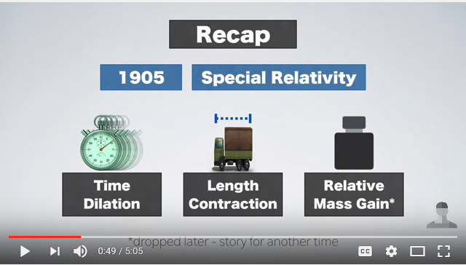
Time dilation and space contraction

Slide 7
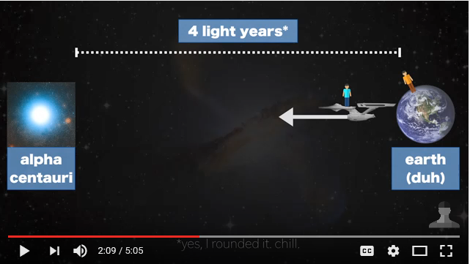
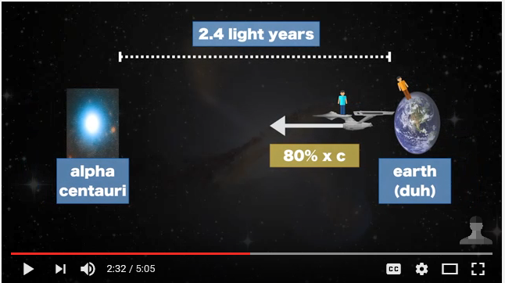
Time Dilation & Space Contraction

Slide 8
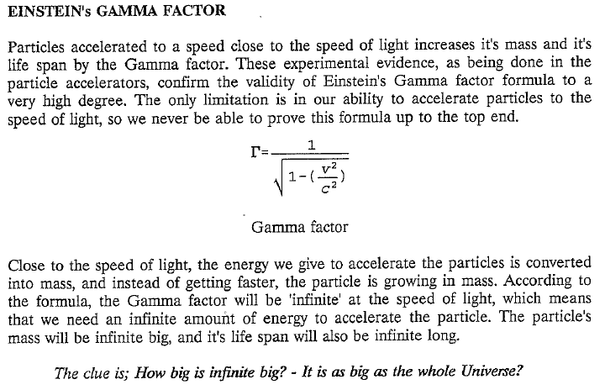
The Gamma factor

Slide 9
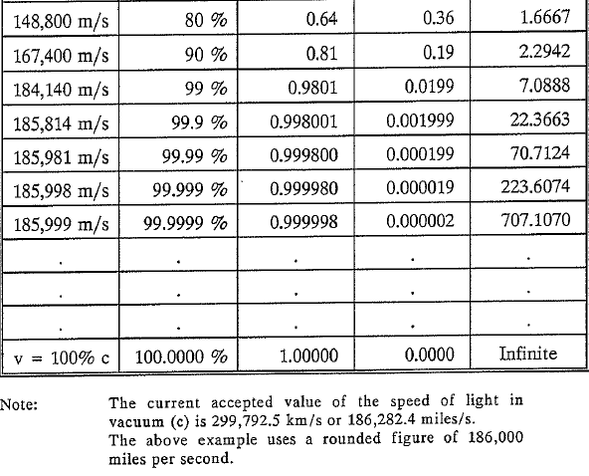
The Gamma Factor as a function of speed

Slide 10
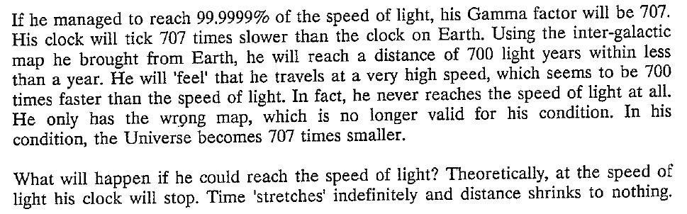
Moving at 99.9999% C

Slide 11
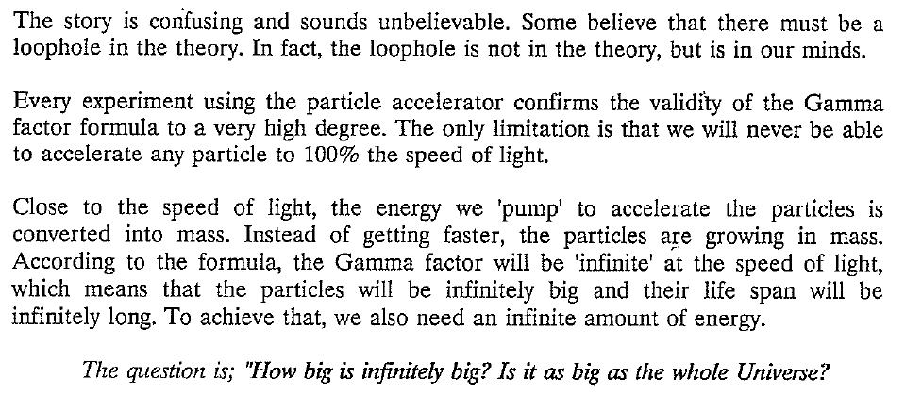
Moving at 100% C ?
This could only happens to massless particles like photons

Slide 12
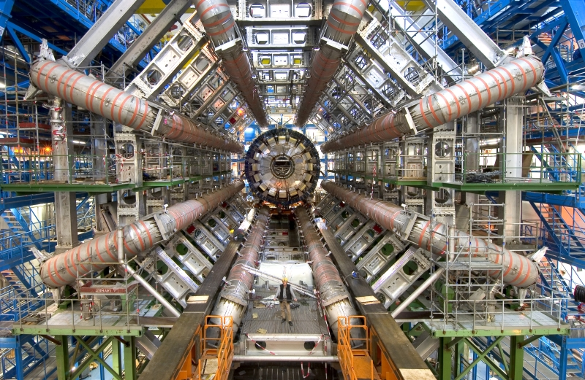
Particle Accelerator and Gamma Factor

Slide 13
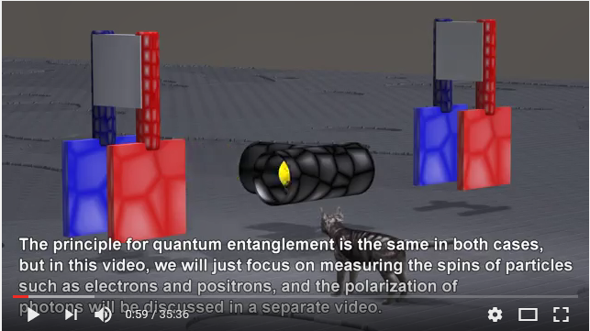
Quantum Entanglement

Slide 14
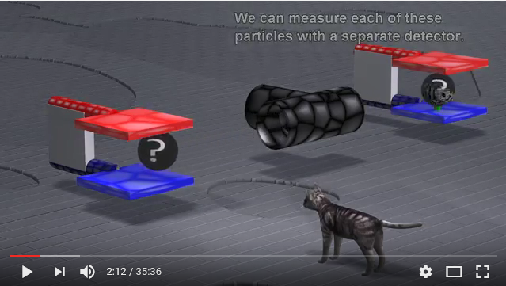
Where is the Gamma Factor?

Slide 15
Quantum Reality
In the quantum realm, there are no discrete actions or separate objects, only an indivisible whole. Even the distinction between observer and perception is erased. Quantum reality is all verbs and no nouns.
Both photons are the same photon – indivisible!
(not just entangled)

Slide 16
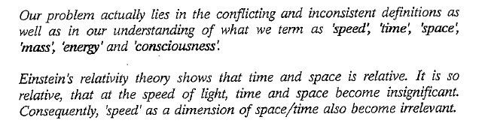
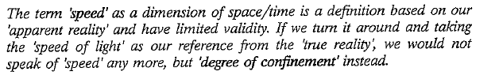
Is there speed at the speed of light?

Slide 17
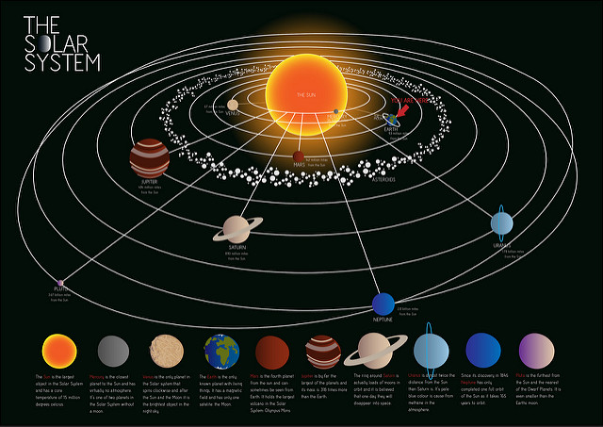
Learning from History
The Retrograde motion of planets

Slide 18
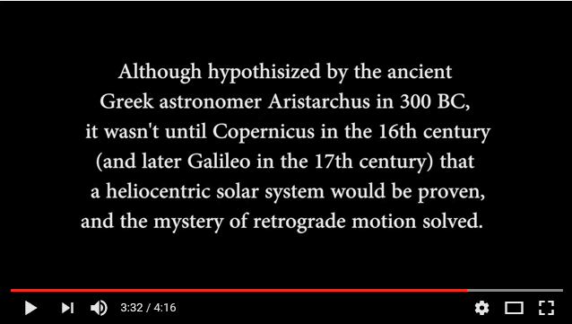
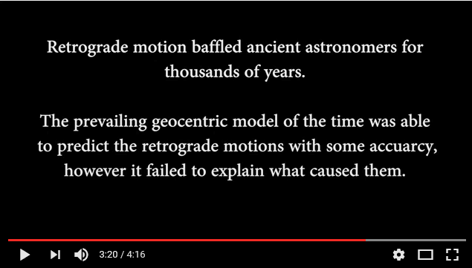
Geocentric & Heliocentric system

Slide 19
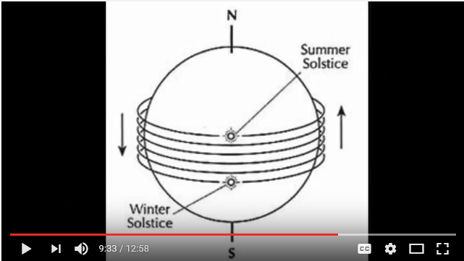
Turning the frame of reference around

Slide 20
Degree of Confinement / Densities
The Implicate Order
The reality of light
V
Light
Sight
wave
photon
causal
mental
Human
The Explicate Order
IV
Sound
Hearing
K
subatomic
particles
astral
emotional
Mammals
Q
III
Gaseous
Smell
atomic
etheric
energetic
Animals
L
P
II
Liquid
Taste
elements
physic
organic
Vegetation
M
O
I
Solid
Touch
Mineral
N
N
crystals inorganic
Thermo nuclear
Fe, Co, Ni
Neutron capture
Electron shells

